Slide 1
Fake and Real news detection
Christodoulos Constantinides
Giannis Alexandrou
Kristian Litsis

Slide 2

What fake news is ?
Fake news is a type of propaganda that consists of deliberate disinformation spread via traditional print and broadcast news media or online social media.

Slide 3
Our approach to this problem
Dataset from fact checking website marked as Real or Fake
Reducing the problem to Near-Duplicate detection problem
Crawling the web searching for similar titles
Using a Locality sensitive hashing algorithm to compare documents
Saving the results in a Database
Evaluating our results

Slide 4
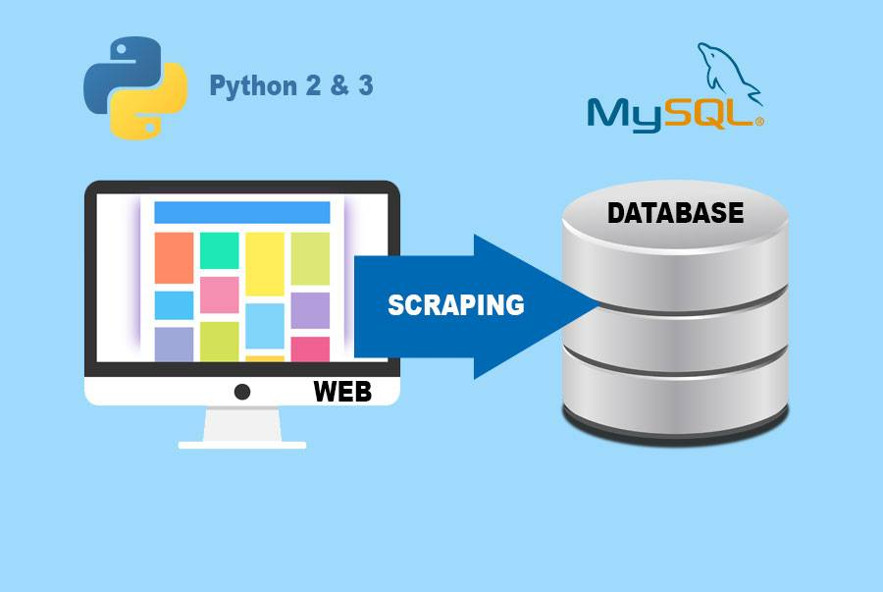
Crawling and Scraping the web
Google custom search engine API for searching the titles
Newspaper API on python for web scraping.
Urllib library for avoiding marking same document.

Slide 5
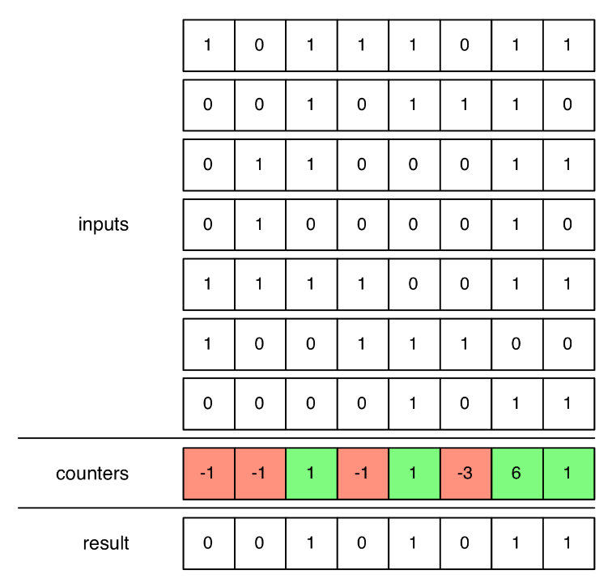
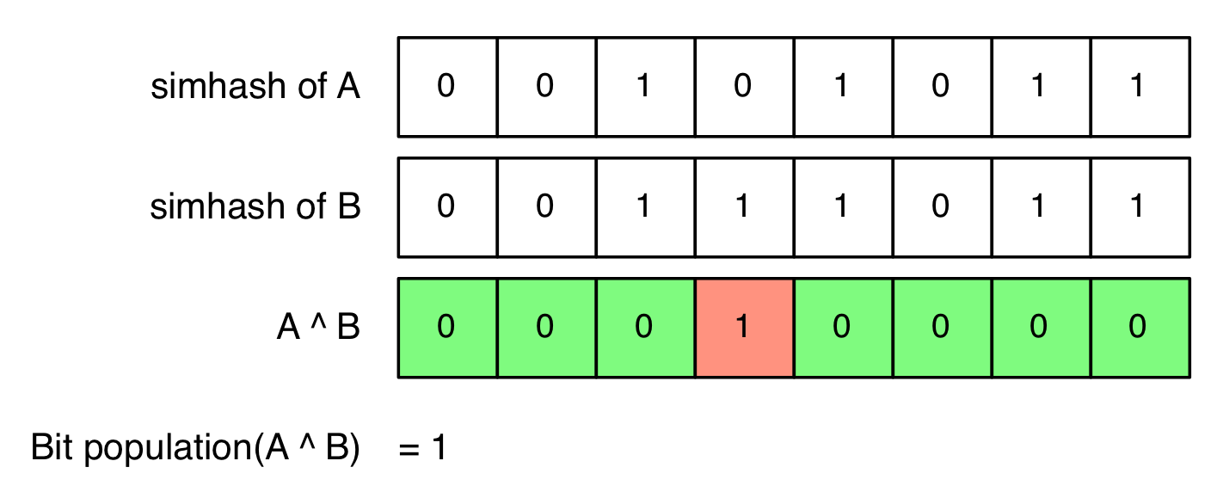
SimHash Algorithm
Calculate k-grams of the document. In our case optimal k is 5.
Using MD5 cryptographic hash function we hash all the shingles.
For each bit position we add 1 if bit set (1) and subtract 1 if bit not set (0).
Once done, every position with negative counter is set to 0 in the result and for every other position is set to 1.

Slide 6
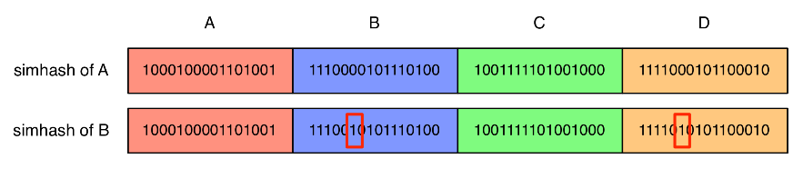
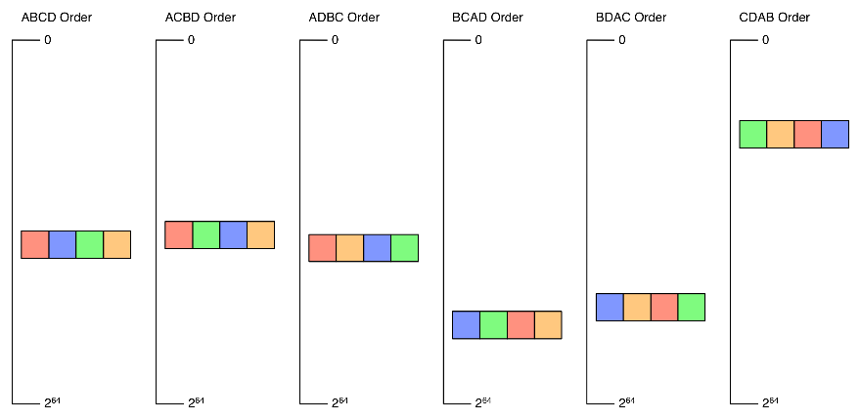
Simhash Algorithm
Divide the hashes into groups
Generate all possible permutations and sort them
Compare the bit difference between neighboring hashes.
The time complexity for this algorithm is O(d*ln(n)) where d is the number of permutations and ln(n) is the time complexity for comparing hashes that share the same prefix.

Slide 7

Storing the results in Database
Why database?
Easy and fast data retrieval
Quality of service
Procedure
Loading the URL and hashes in main memory and then comparing each candidate document.

Slide 8
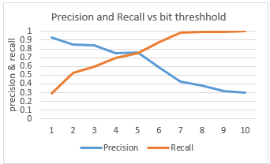
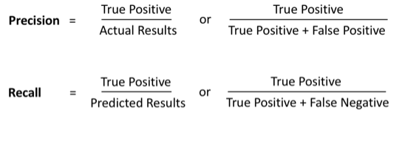
Evaluation
Sample of 20 documents
Tried with different bit threshold to see how precision and recall varies to find the optimal.

Slide 9
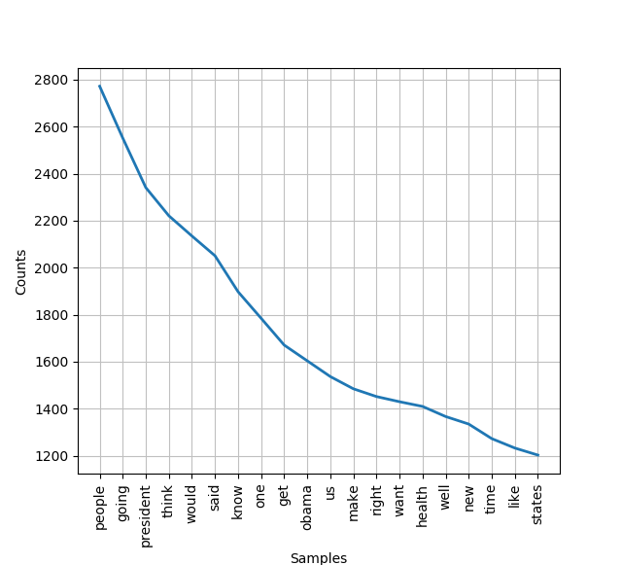
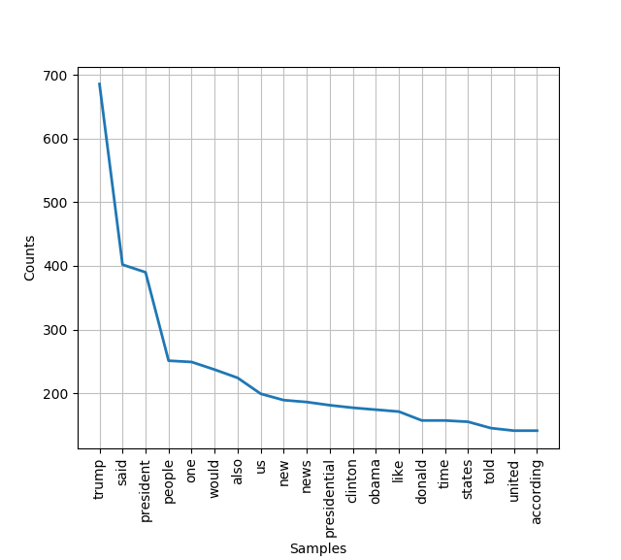
Conclusions
Frequency of words in True Dataset
Frequency of words in False Dataset
We used NLP techniques to find the most important words of each dataset.
False political information tends to spread “3 times” faster than other false news.
Most frequent words have to do with the politics.
According to the dataset that is given we notice that the articles have to do with the presidential elections in America.

Slide 10


Conclusion
The bit threshold is affected by the fact that websites carry extra information apart from the main content which are also scraped causing the ideal bit threshold to increase.
LSH algorithms cannot detect duplicate documents expressed with different words
There were also some false positives from the websites that redirected the request to a specific page usually for authentication or subscription purposes.

Slide 11

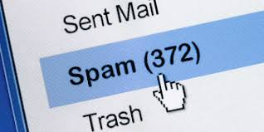
Related work
Find related-pages, for identifying web mirrors.
Detecting near-duplicates for spam detections in emails.
Near-duplicate detection to reduce storage for files and indexes.

Slide 12
Thank you for your attention! Any questions?

